Slide 1
Mouse Brain Slice
Reorientation Pipeline

Slide 2
Core Pipeline Design
01
02
03
04
05
Load & Normalise
Tissue Mask
Atlas Match
PCA Rotation
Flip Resolve
PNG / TIFF / CZI → float32 [0,1]. Polarity detection: compare central vs corner medians to determine if tissue is bright or dark.
Li threshold (fallback Otsu), morphological closing, fill holes. Keep up to 3 largest connected components.
15–25 candidate atlas slices per axis. Fast NCC pre-screen → top-3 → full per-rotation NCC. Return best-matching atlas slice.
Score each 90° rotation: 0.7 × cos(PCA angle residual) + 0.3 × NCC. Winner recorded with NCC margin over 2nd-best.
Coronal/axial: test none / lr / ud / both flips against atlas via NCC. Sagittal: shape-adaptive landmark module, no atlas rotation step (see next slide).

Slide 3
Sagittal Flip Resolution
The Problem
Shape-Adaptive Landmark Module
1.
Sagittal slices are near-bilaterally symmetric. A left-hemisphere and right-hemisphere slice produce almost identical NCC scores against the same average atlas.
Flipping left↔right changes little in intensity — the atlas carries no strong laterality signal.
Result: NCC-based flip resolution is unreliable for sagittal views — the fix now skips atlas comparison for this axis entirely and reasons from tissue shape instead.
Classify shape: the mask’s short/long-axis aspect ratio sorts each slice into “circle” (aspect > 0.62) or “elongated” — each routed to its own landmark logic.
2.
Elongated: split the tissue at its narrowest “neck” (watershed) to isolate the cerebellum blob, falling back to end-to-end texture contrast if the split fails.
3.
Circle: locate an internal circular structure via radial-symmetry transform (edge voting, ring count, grain penalty).
Either landmark found is flipped left-right onto the right side of the frame.
4.
Wider-half-on-top check: PCA splits the mask into top/bottom halves and compares cross-sectional width.
5.
The narrower half is flipped to the bottom; circle slices use a mean-width tiebreaker when the margin is small.

Slide 4
Results — Quantitative Metrics
Coronal
Sagittal
Axial
Overall
0.843
0.775
0.884
0.834
Dice
Dice
Dice
Dice
HD 0.103 NCC 0.572
HD 0.171 NCC 0.435
HD 0.063 NCC 0.775
HD 0.112 NCC 0.594
Axis
n
Dice ↑
HD_norm ↓
NCC ↑
Latency (ms)
Coronal
24
0.843
0.103
0.572
~183
Sagittal
24
0.775
0.171
0.435
~173
Axial
24
0.884
0.063
0.775
~193
Overall
72
0.834
0.112
0.594
~183

Slide 5
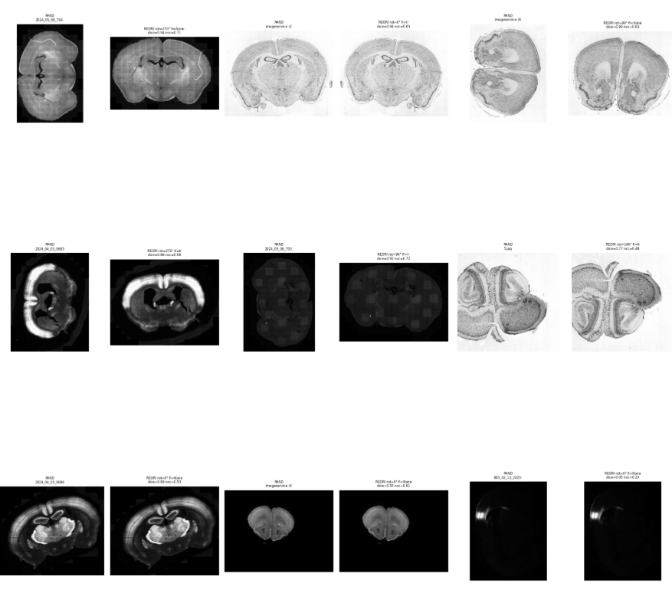
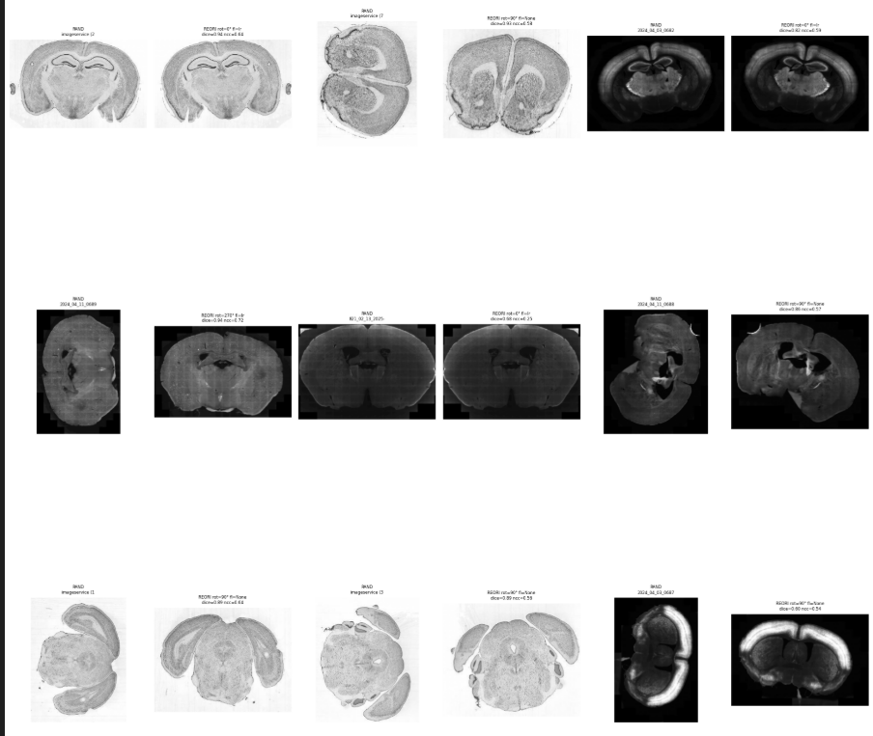
Results Grid — Coronal

Slide 6
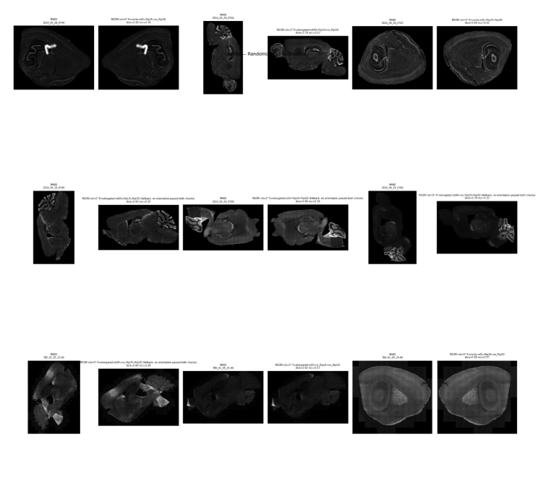
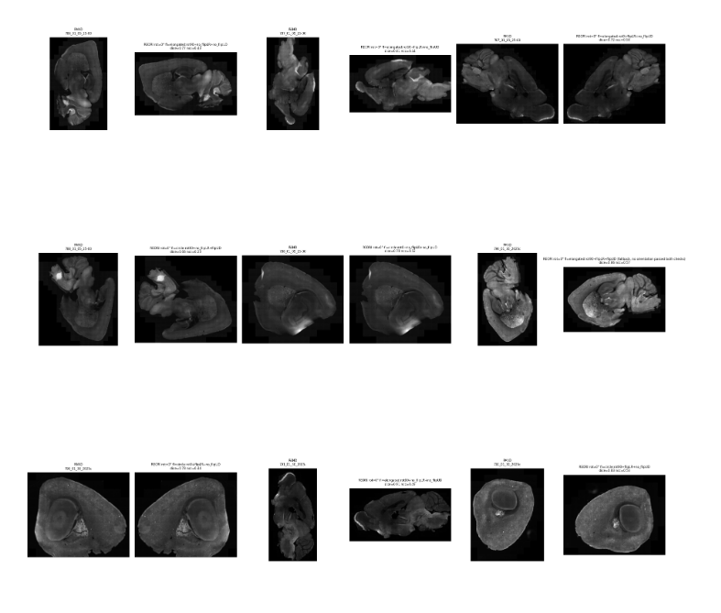
Results Grid — Sagittal

Slide 7
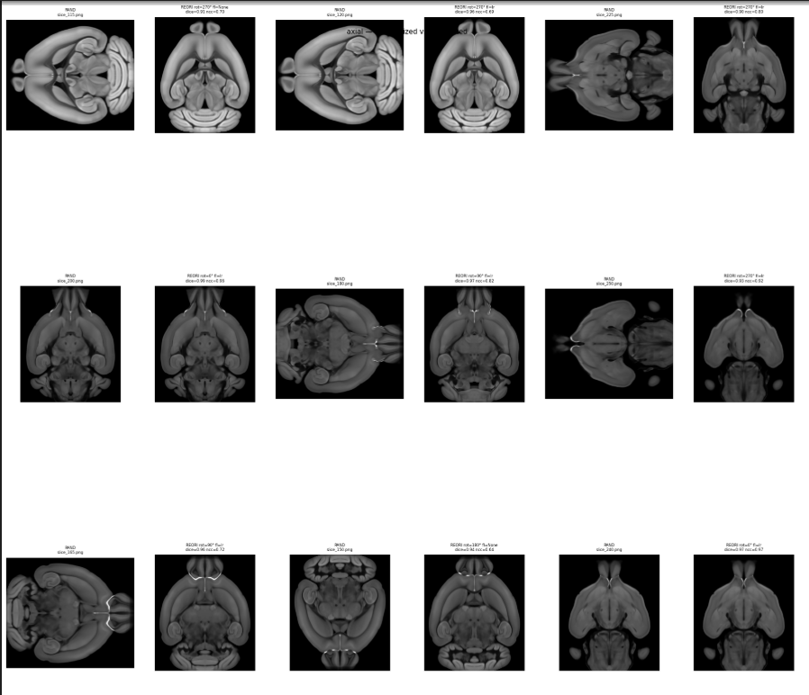
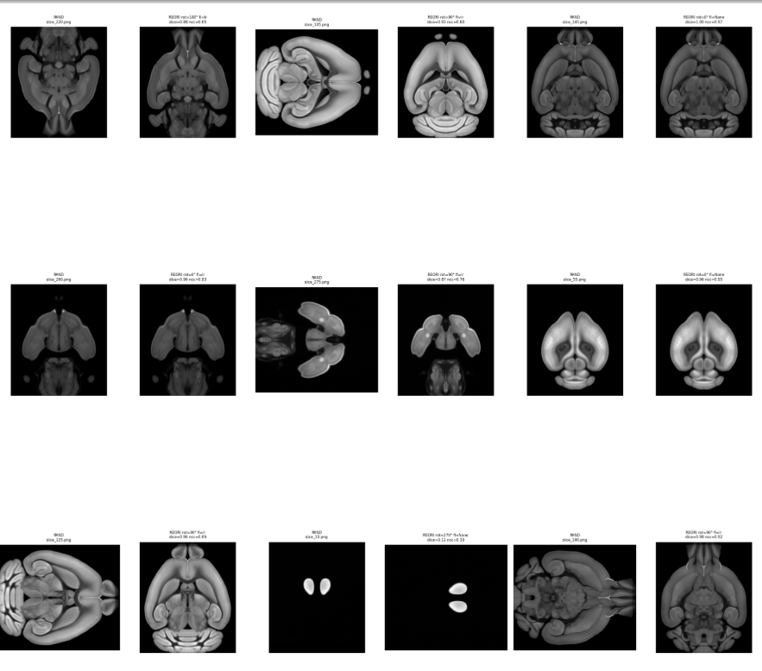
Results Grid — Axial

